Slide 1
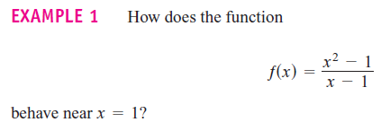
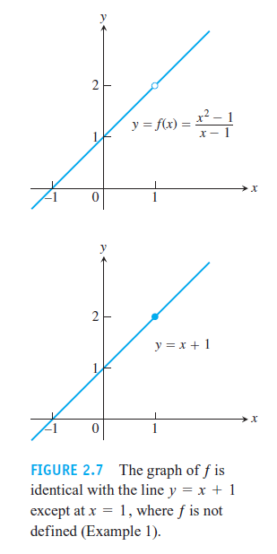
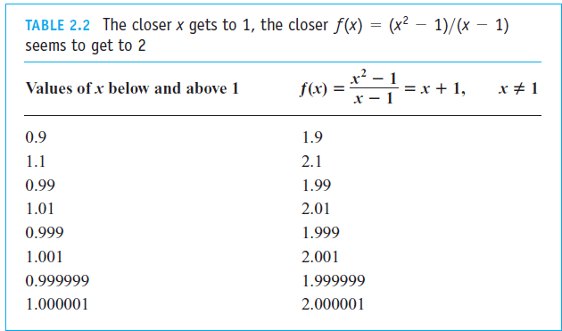
Section 2.2 Limit of a function and
Limit laws

Slide 2




Slide 3
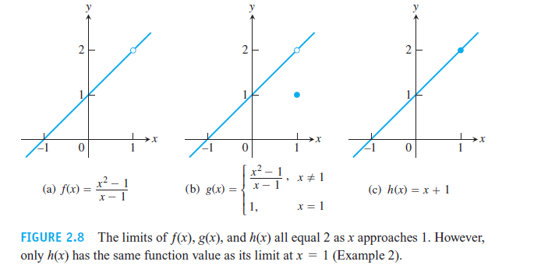
EXAMPLE 2 This example illustrates that the limit value of a function does not depend on how the function is defined at the point being approached. Consider the three functions in Figure 2.8. The function ƒ has limit 2 as x → 1 even though ƒ is not defined at x = 1.

Slide 4
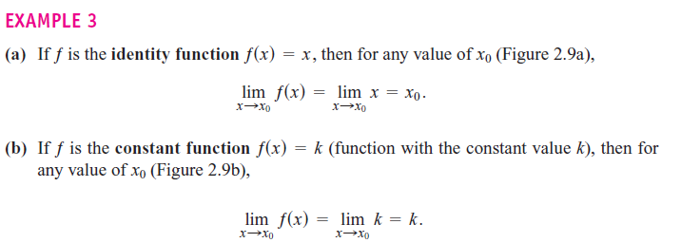
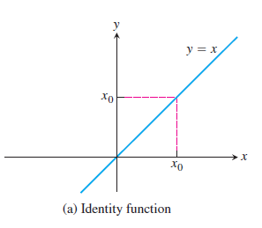
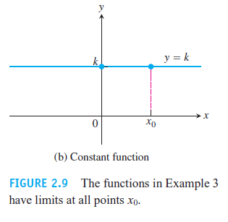

Slide 5
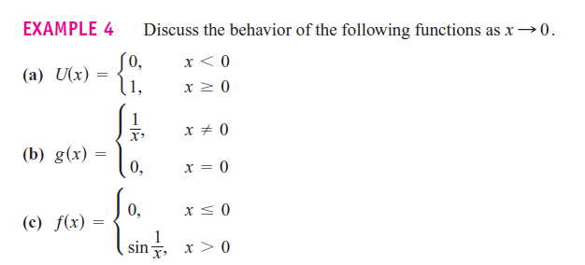


Slide 6
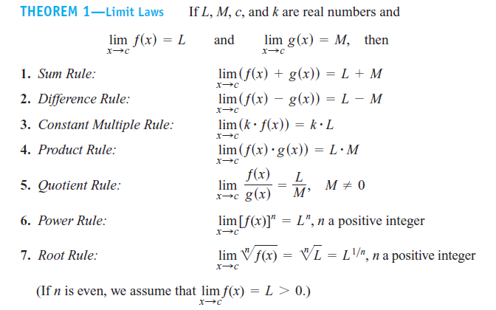

Slide 7


Homework 1:

Slide 8



Slide 9


Slide 10


Eliminating Zero Denominators Algebraically
Example:

Slide 11

Example
Find
(1)
(2)

Slide 12

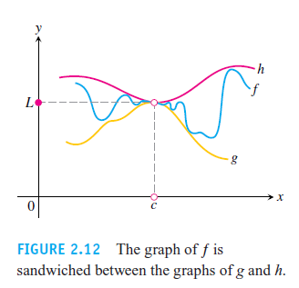

Slide 13



Slide 14



Slide 15
Homework 2: Page74 24, 28, 36, 40, 61,63

